Slide 1


POPULATION
PREDICTION
OF INDIA
MADE BY
BOT ARMY
HRISHANK CHHATBAR
ATHARVA DESHPANDE
Division: Ty-btech-ECE-C
School: School oF EnTc

Slide 2
01
02
03
Introduction
Procedure
Visuals
A brief intro on our understanding of the problem statement
Our approach on the problem statement and Optimal solution
Some visuals from what we have executed.

Slide 3
“The goal is to turn Data into information and information into insight”.
— Carly Fiorina

Slide 4
01
INTRODUCTION

Slide 5
UNDERSTANDING THE PROBLEM
As we know that population of India is rising Constantly at a higher growth rate.This leads to many problems in a nation including scarcity of food, Increasing use of natural resources and many different problems.
So as a nation its very Important to plan for the future accordingly. For planning we need to roughly understand what is the rate at which population is increasing and we need to know approximate population and analyze the population trends for further few years.
So our team by working on this project are trying to predict what would be the population status of India in next few years.

Slide 6
02
OUR SOLUTION

Slide 7
PROCEDURE
Dataset :- We extracted the dataset of Population of India from Kaggle where we were provided with data of nations population from independence till now(2021) along with its growth rate.
Data Analysis :- Once the dataset is loaded we performed different functions to understand the general pattern of data and then we tried to understand the relation amongst different attributes that are Population (output variable),Year, Growth Rate. We performed univariate analysis with respect to theses variables and Plotted Heatmap and corrplot to understand the correlation among different attributes.

Slide 8
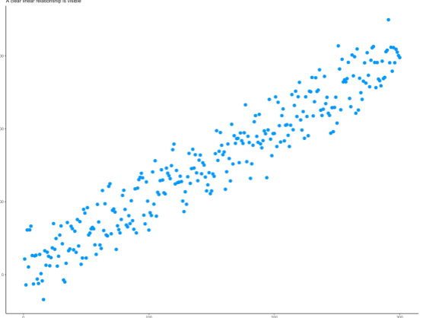
Contn
c) Statistical Modelling :- Once we realized that there are no categorical Columns as well as no missing values in our dataset we needed to find the value of R2 and adjusted R2 to find out what are the statistical relations among different columns of our dataset.
d) Model Building :- Model building is one of the most important part of our Data Science Project because it is the segment where we are going to get our Predictions for the future population. For our Project we have used Linear Regression model because we want our output in form of continuous valued population prediction for future years.

Slide 9
VISUALS

Slide 10
THESE ARE SOME OF THE INSIGHTS WE GoT!
0.46%
300.4M
20.78 Year
Growth rate goes down by
<-
The average of Population increases by
->
When years go up by
->

Slide 11
CORRELATION
Population
VS
Year
Growth Rate
VS
Year
Population
VS
Growth Rate
CORRELATION: 0.99
VERY HIGH POSITiVE CORRELATION
CORRELATION: -0.47
MEDIUM NEGATIVE CORRELATION
CORRELATION: -0.55
MEDIUM NEGATIVE CORRELATION

Slide 12

THANK YOU

